Slide 1
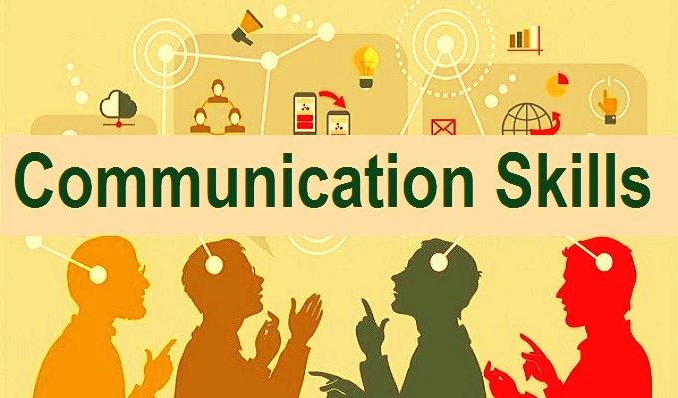
Rajesh G
Principal, DTI,Shivamogga

Slide 2
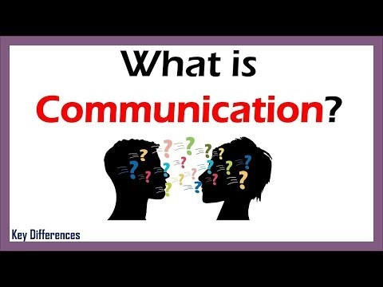
Communication -Latin word- communi care
One on one
One to many
Many to one

Slide 3
Three forms
Speaking
Writing
Gestures
Telephonic conversation,group discussion
e mail,notes,letters
Anger,smile,hand and finger movements

Slide 4
‘Why’ questions
◼Why didn’t you take your medication?
◼Why did you take an overdose?
◼Why did you discharge yourself from hospital?
Alternative phrasing
◼What stopped you from taking your medication
◼What made you take an overdose?
◼ What happened that led you to discharge yourself?

Slide 5
◼ E.g., ‘I don’t think you are very happy with your husband?’
rather than,
‘How do you feel towards your husband?’ which encourages person-centered communication rather than counselor-led communication

Slide 6
“Woman, without her… man is worthless”
“Woman, without her man…… is worthless”

Slide 7
“He Died”
“He Died”

Slide 8
Bird – An Anniversary Gift
Activity - Holding balloon
Passing the information

Slide 9
ದಶರಥ ಮಹಾರಾಜನ ಮಗನು ಹಾಗೂ ಪಿತೃ ಪರಿಪಾಲಕನಾದ ಶ್ರೀರಾಮಚಂದ್ರಪ್ರಭು ಸತಿ ಸೀತಾದೇವಿ ಹಾಗೂ ಸಹೋದರ ಲಕ್ಷ್ಮಣನೊಂದಿಗೆ ಹದಿನಾಲ್ಕು ವರ್ಷಗಳ ಕಾಲ ವನವಾಸಕ್ಕೆ ತೆರಳಿದರು.

